Slide 1


International Insurances
Welcome
QUICK ● EASY ● SURE

Slide 2

International Insurances
Coby Elsendoorn
QUICK ● EASY ● SURE

Slide 3
Program
Introduction
Dutch Public health insurance
Insurances for students
Working during your study
Flex Delft
Health insurance while working
Care allowance, “Zorgtoeslag”
Medical care
Practical tips
QUICK ● EASY ● SURE

Slide 4
Introduction
International Insurances is part of Alpina
We are an insurance advisor and we are the link between customers and insurance companies
We advise employees and students of TU Delft about health insurances
You can contact us for:
  Information and advice
  Support and changes in your situation during your stay in the Netherlands
QUICK ● EASY ● SURE

Slide 5
How to contact us
When you have questions, need help, when your situation is changing or when your partner is joining you, please contact us
      Please call 088 – 121 0 221 or send an email to tudelft@internationalinsurances.nl
      Or visit our website
      www.internationalinsurances.nl/tudelft
QUICK ● EASY ● SURE

Slide 6
Dutch public health insurance
Regulated by law
Mandatory for everybody living (and working) in the Netherlands
Coverage is decided by the government
Many insurance companies in the Netherlands
TU Delft collective health insurance for employees with OHRA and Zilveren Kruis
QUICK ● EASY ● SURE

Slide 7
Dutch public health insurance
Exceptions
If you have no income and intend to stay temporarily you are not allowed to have the public health insurance
International students without income
Guest researchers
QUICK ● EASY ● SURE

Slide 8
Insurances for students
How can a student (or guest researcher) be insured?
Public health insurance from home (EHIC)
International (travel) private health insurance
Dutch private (student) health insurance
QUICK ● EASY ● SURE

Slide 9
EHIC
European Health Insurance Card
https://www.zilverenkruis.nl/naar-nederland/studeren-in-nederland?sc_lang=en
QUICK ● EASY ● SURE

Slide 10
EHIC
Follow-up
Tips for students with EHIC
Check with insurance company/institution, if insurance/EHIC will stay valid for 100% during entire study abroad/TU Delft/in the Netherlands!
Try to get the confirmation on paper
QUICK ● EASY ● SURE

Slide 11
International health insurance
Insurance check
Tips for students with international insurance
Check if the reimbursement is sufficient for medical care in the Netherlands (maximum amount medical coverage; repatriation; liability insurance)
International Insurances can help you / check the coverage overview from your insurance
QUICK ● EASY ● SURE

Slide 12
Private student insurance
MasterPlan+ with insurance company InsureToStudy
Health insurance plus coverage for liability, household effects, luggage, emergencies and repatriation
Website with information, benefits, extent of cover, terms of the insurance and how to join
https://www.internationalinsurances.nl/tudelft
QUICK ● EASY ● SURE

Slide 13
Private student insurance
Important is to have a liability insurance in the Netherlands.
The financial complications could be enormous if someone is holding you, accountable for damage you caused unintentionally.
- Damage the personal belongings from another person.
- Hurt someone
QUICK ● EASY ● SURE

Slide 14
Private student insurance
When you do have a liability insurance, the insurance company will stay in contact with the other person and investigate if you are to blame due to law and regulations.
When you are to blame, the insurance company will compensate the other person.
QUICK ● EASY ● SURE

Slide 15
Private student insurance
Liability examples:
- Accident with another cyclist
- You drive your bike into a parked car
- In a store, you knock over expensive items through your backpack
- You're spilling red wine on an expensive, white carpet from your friend
QUICK ● EASY ● SURE

Slide 16

Private student insurance
Insurance company is InsureToStudy
Contact information
        Telephone 070 – 205 1 860
        Email info@insuretostudy.com
QUICK ● EASY ● SURE

Slide 17
Working during your study
Internship
Employment
QUICK ● EASY ● SURE

Slide 18
Internship
Internship
As part of your study you will work for a company. Sometimes you will receive an internship allowance.
When your internship allowance is less than the minimum wage in the Netherlands, you don’t have to swith to the public insurance.
https://www.rijksoverheid.nl/onderwerpen/minimumloon/bedragen-minimumloon/bedragen-minimumloon-2025
QUICK ● EASY ● SURE

Slide 19
Work during your study
If you earn income in the Netherlands, you have the legal obligation to take out a Dutch health insurance (public insurance) per the starting date of your working contract. (Even when you have a small income).
For example:
  working as a teaching assistant
  (usually through FlexDelft)
  A sidejob for example as waiter or delivery
QUICK ● EASY ● SURE

Slide 20
Work during your study
When you stop working you must terminate your public health insurance
And you must stop the care allowance
QUICK ● EASY ● SURE

Slide 21
FlexDelft
Work contract
Your work assignment for the current job. It has the start and end date mentioned in it. It is called confirmation working activities.
During the time of this contract, you need to have the Dutch basic health insurance
QUICK ● EASY ● SURE

Slide 22
Health insurance while working
When you receive income from employment you must have a Dutch public health insurance
Through InsureToStudy we offer also the Dutch public insurance
Advantage, easily switch between student insurance to Public insurance
Add additional insurances
Care allowance
QUICK ● EASY ● SURE

Slide 23
Dutch public health insurance with HollandZorg
Specializes in temporary Dutch Public health insurances, through InsureToStudy.
Standard package is the basic health insurance and the supplementary insurance No Risk I and II
  No mandatory excess (of 385 euro)
  Included is emergency dental up to 200 euro
  Premium 2025 is per month € 164,70
QUICK ● EASY ● SURE

Slide 24
Dutch public health insurance with HollandZorg
More information: https://www.hollandzorg.com/NR3-25-ITS
QUICK ● EASY ● SURE

Slide 25
Additional insurances
BasicPlan with InsureToStudy
  Provides coverage for liability, household effects, luggage, emergencies and repatriation (also included in MasterPlan+)
  Extent-of-cover-Basic-Plan.pdf (internationalinsurances.nl)
BasicPlan+ with InsureToStudy
  Provides additional medical coverage
  € 150 dentist and € 180 Physiotherapy cover
HollandZorg No Risk III
  Provides additional medical coverage
  Physiotherapy: 6 sessions
  Dental care up to € 250 per calendar year
QUICK ● EASY ● SURE

Slide 26
Care Allowance “Zorgtoeslag”
The right to receive the care allowance is from the 1st of the month after the start date from your Dutch basic health insruance.
For example: start date working contract 4th of September. Start date Dutch basic health insurance 4th of September. Start date to receive the care allowance 1st of October.
PAY ATTENTION: with a private student insurance you have no rights for the care allowance!
QUICK ● EASY ● SURE

Slide 27
Care Allowance “Zorgtoeslag”
More information you find on the following websites:
I want to apply for a benefit (belastingdienst.nl)
https://www.belastingdienst.nl/wps/wcm/connect/nl/zorgtoeslag/content/hoeveel-zorgtoeslag
https://www.belastingdienst.nl/wps/wcm/connect/nl/toeslagen/content/wat-is-mijn-toetsingsinkomen
QUICK ● EASY ● SURE

Slide 28
Medical Care
General Practitioner
Emergency medical care
QUICK ● EASY ● SURE

Slide 29
Medical Care – General Practitioner (1)
General Practitioner “huisarts”
First place to go for medical care in the Netherlands
Student healthcare services (SGZ), located on campus
https://www.sgzstudent.nl/home
General practitioner
How to find one
Do a search through google: Huisarts, streetname, city
General information
https://www.internationalinsurances.nl/faq/
QUICK ● EASY ● SURE

Slide 30
Medical Care – General Practitioner (2)
General Practitioner in the evening, nights and weekend
Contact the Huisartsenpost / General Practice Center in your city
It has to be something that can’t wait till the next day
(otherwise, it isn’t part of the reimbursement scheme!)
For Delft this is
https://hapschievliet.nl/locatie/huisartsenpost-delft/
Phone number 015 – 251 1930
QUICK ● EASY ● SURE

Slide 31
Emergency medical care
In case of emergency, you call 112
  For urgent medical care, life-threatening situations
  Fire
QUICK ● EASY ● SURE

Slide 32
Practical tips
Update your address with the municipality
Pay insurance premium on time
Read letters your receive from the CAK, SVB
QUICK ● EASY ● SURE

Slide 33
Practical tips
Update address
Update your address with the municipality. If you don’t update your address, you might not receive important letters from government offices like CAK or SVB.
QUICK ● EASY ● SURE

Slide 34
Practical tips
Pay your insurance premium on time
  Private insurance – you’ll receive a payment link by email
  Dutch basic health insurance – usually paid automatically via direct debit
  Missing payments can lead to problems, so check your email or bank regulary
QUICK ● EASY ● SURE

Slide 35
Practical tips
Letter from the CAK
The CAK, is a Dutch government organisation responsible for monitoring if people living in the Netherlands have Dutch basic health insurance (Public insurance)
However, the CAK can’t determine if you are required to have the public health insurance
QUICK ● EASY ● SURE

Slide 36
Practical tips
Letter from the CAK, follow-up
Important information is:
  If you work while studying
  You must take out Dutch basic health insurance.
  This applies whether you are working part-time or full-time
  If you don’t work
  You must ask the SVB (Sociale verzekeringsbank) to conduct a
  WLZ right investigation. This will determine if you are required to
  have Dutch health insurance
  SVB will inform you and the CAK about the outcome of the investigation
QUICK ● EASY ● SURE

Slide 37
Practical tips
Letter from the CAK, what happens next
First letter
You must take action when you recieve the firt letter. If you don’t act, you will receive a fine (apply for Dutch basic health insurance or ask SVB to conduct an investigation)
Second letter
if you did not act on the first letter you receive a reminder and a fine.
Final step
If you still don’t act, the CAK will automatically register you for Dutch
basic health insurance with a higher premium
QUICK ● EASY ● SURE

Slide 38
Practical tips
Information about the CAK
For more information on the CAK and how to act:
Questions and answers about being uninsured - CAK (hetcak.nl)
Or watch this YouTube video https://www.youtube.com/watch?v=EZt36Ciy5nA
For advice, contact International Insurances
QUICK ● EASY ● SURE

Slide 39
Practical tips
Information about SVB
  The SVB is another Dutch government organisation.
They can check your status as resident and determine if you are eligible for the public health insurance or not
  For more information on SVB and how to start an Wlz assessment: Letter from the CAK | Wlz | SVB
QUICK ● EASY ● SURE

Slide 40


Questions?
QUICK ● EASY ● SURE

Slide 41
How to contact us? tudelft@internationalinsurances.nl or call 088 – 121 0 221 www.internationalinsurances.nl/tudelft
QUICK ● EASY ● SURE

Slide 42
End
QUICK ● EASY ● SURE

Slide 43
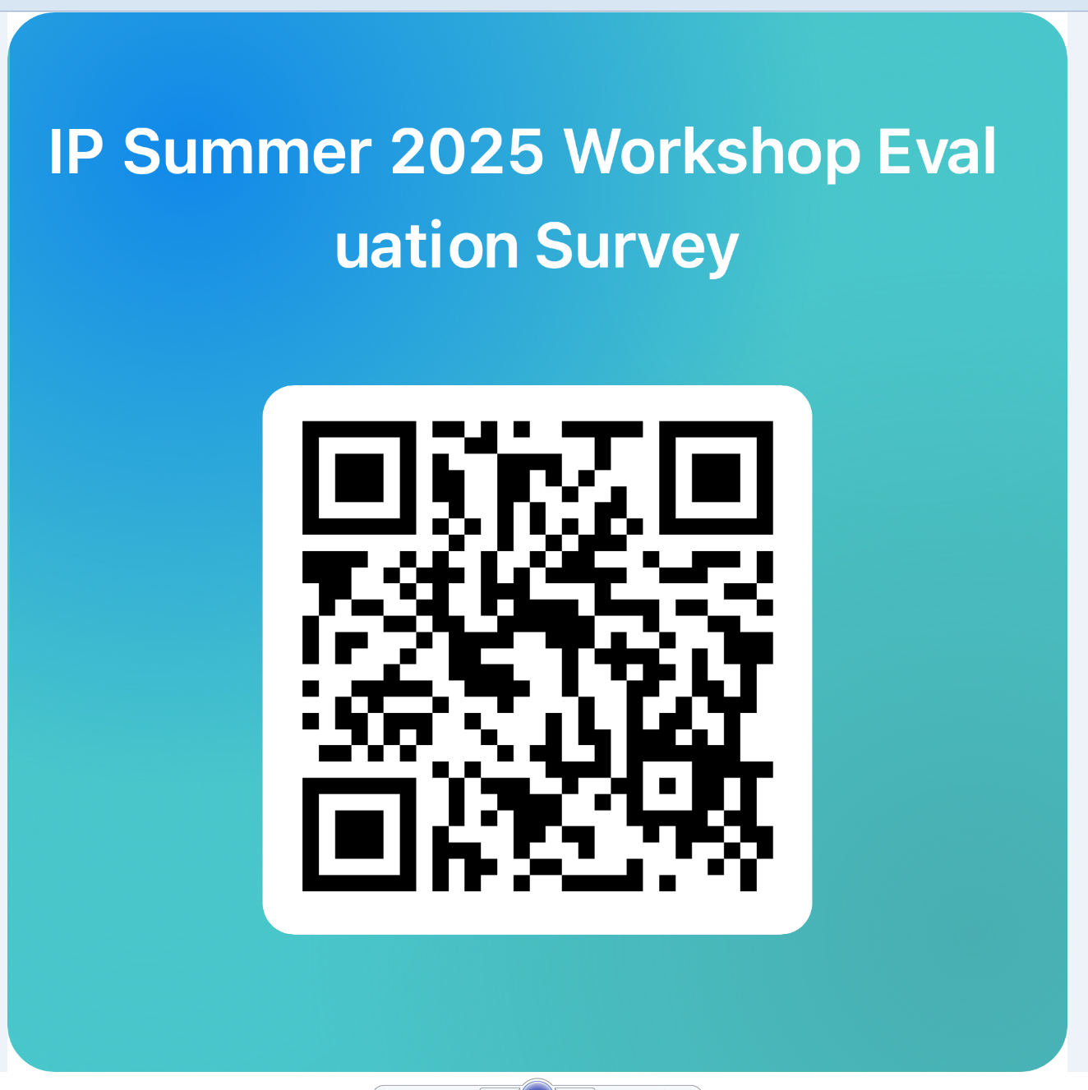
QUICK ● EASY ● SURE

